Slide 1
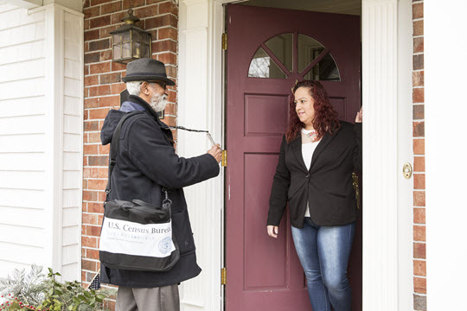
October 2019 US Census Updates
Presented By: Maria Vianey Cardenas
Havala Schumacher
Partnership Specialists, US Census Bureau

Slide 2
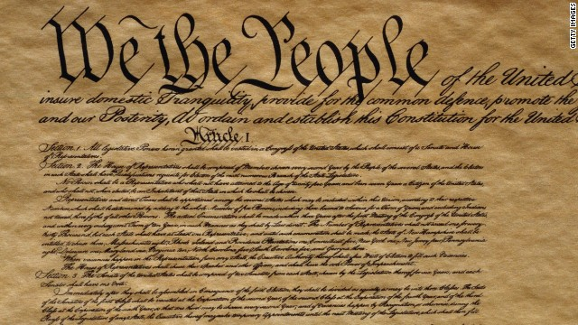
Why We Do A Census
Article 1, Section 2 of the US Constitution
The actual Enumeration shall be made within three Years after the first Meeting of the Congress of the United States, and within every subsequent Term of ten Years, in such Manner as they shall by Law direct.

Slide 3
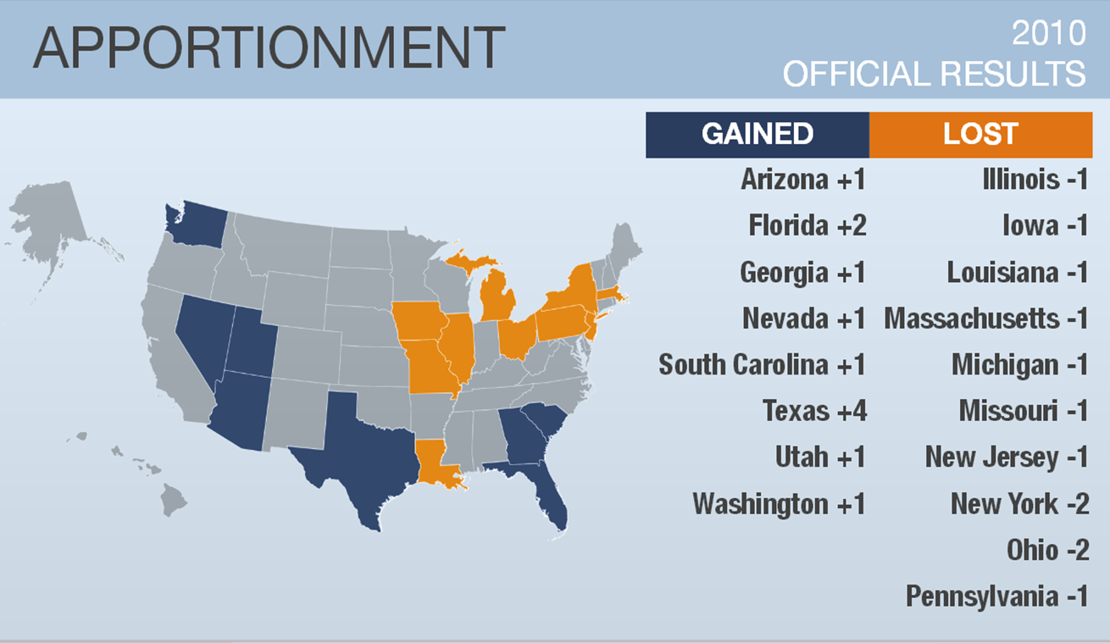
What’s At Stake

Slide 4
2020 Census vs 2010 Census
In 2020, we will introduce new technology to make it easier than ever for individuals to respond to the census.
For the 1st time, you will be able to respond online, by phone, or by mail. We will use data that the public has already provided to cut down on household visits.
We are building a more accurate address list and automating our field operations—all while keeping your information confidential and safe.
Notes:
City limits = light blue
Pinal county about 50/50 for TEA 1 (self-response) and TEA 6 (update leave)

Slide 5
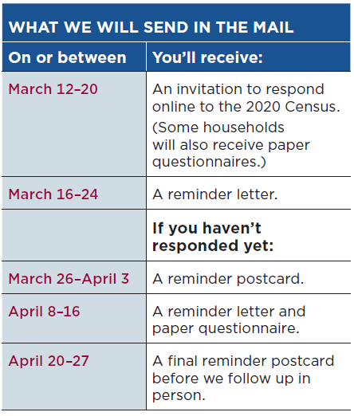
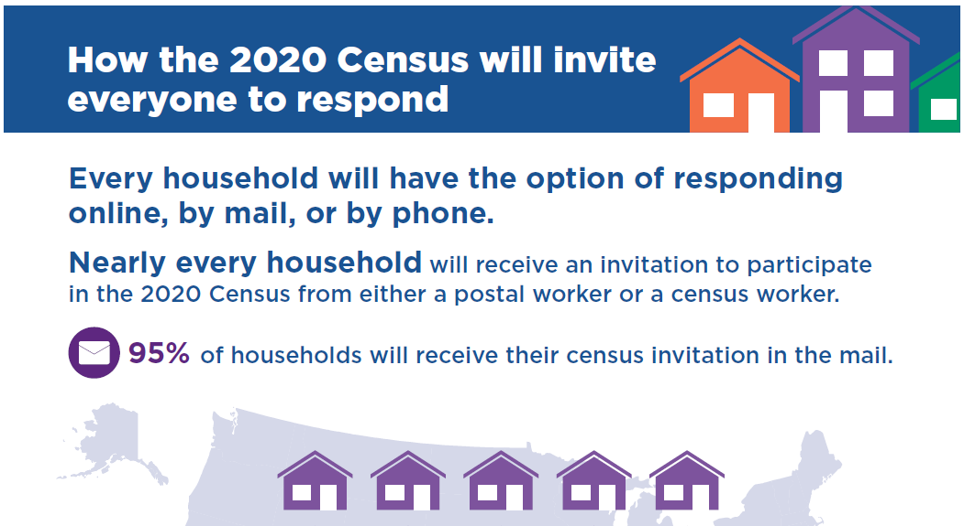
How Households Will Be Invited To Respond

Slide 6
Confidentiality
All responses provided on the 2020 Census questionnaire or to a Census Bureau employee are confidential and protected under Title 13 of the U.S. Code
We will never share a respondents personal information with other government agencies
Results from the census are reported in statistical format only
Records are confidential for 72 years by law (Title 44, U.S. Code)
All Census Bureau employees swear a lifetime oath to protect respondent information.
Penalty for wrongful disclosure is up to 5 years imprisonment and/or a fine of $250,000

Slide 7
Jobs
National Processing Center (NPC) in Phoenix is hiring!
Full-time positions
Veteran’s Preference eligibles encouraged to apply
www.usajobs.gov
Recruitment ongoing for other positions:
www.2020census.gov/jobs

Slide 8
Statistics in Schools

Slide 9
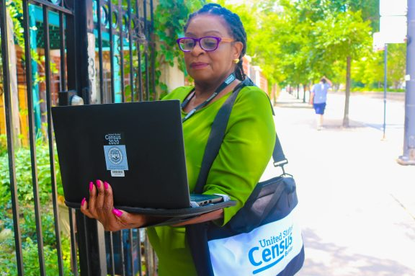
Address Canvassing
Now through October
Listers WILL knock on doors
Inform your communities!
See more at:
https://www.census.gov/newsroom/press-kits/2018/2020-adcan.html

Slide 10
Sample Questionnaire Now Available
Began printing on July 2nd
9 Questions
Sample forms available for viewing:
https://www.census.gov/programs-surveys/decennial-census/technical-documentation/questionnaires/2020.html

Slide 11
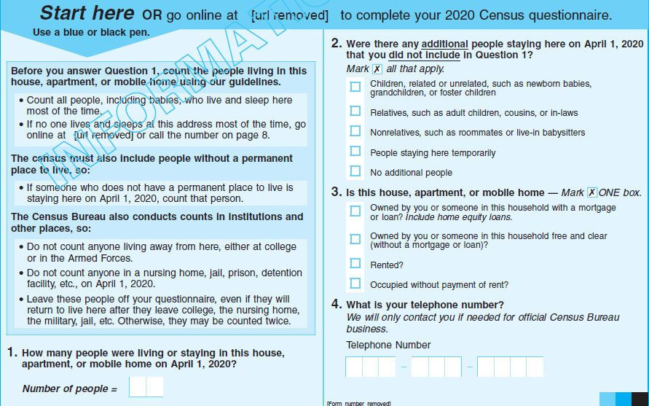
Questions/Questionnaire

Slide 12
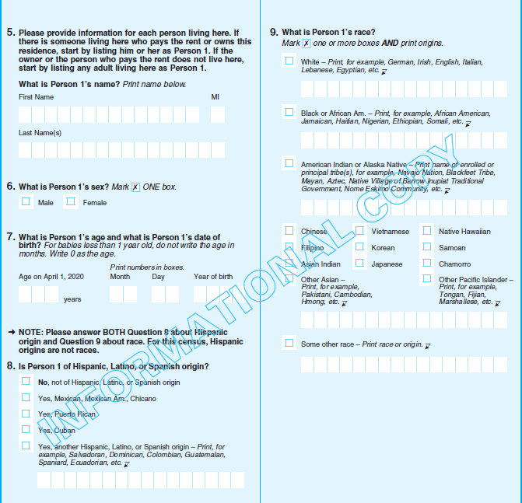
Questions/Questionnaire

Slide 13
Count EVERYONE…
Once
Only Once
In the Right Place
Your community deserves to be SEEN and COUNTED!
Notes:
Allow everyone to ask questions!

