Slide 1
Maintenance
Is a very important part of the overall management of the property and should be a regular and consistent routine to:
-Replace burnt out lights as soon as noticed.
(Keep a monthly maintenance schedule to help with this)
-Clean the covers on all lights.
-Cover or remove graffiti immediately.
-Keep landscaping trimmed.
-Repair vandalism as soon as possible.
-Keep property clean of debris or hazards.

Slide 2
Maintenance
Dirt and bugs reduce light output by as much
as 50% so keep the light fixtures clean to
improve lighting.

Slide 3
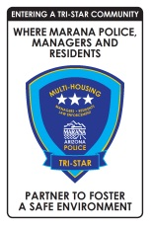
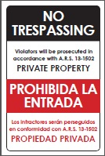
Programs

Slide 4
Marana Tri-Star Program
Once Level III has been achieved, the property will be fully certified Tri-Star and will be authorized to purchase program signage.
The program sign is at a cost to the property.

Slide 5
Trespass Enforcement
Are you having problems with unwanted visitors on your property?
The Trespass Enforcement Program was created specifically to help with incidents of trespassing and loitering.
Once your completed Trespass Enforcement Request has been received, two stickers will be sent to you to place in visible locations on the property, so Marana Police officers know you are participating in the program.
Program is renewed every 12 months.

Slide 6
Trespass Enforcement
Once your property has been registered with the Marana Police Department and you have signs posted, an officer will then be able to trespass an individual from your property who does not have a legitimate reason to be there, without contacting or having a property owner or manager present.
IMPORTANT NOTE ­­ In order for rental properties to participate in this program, they must have a common area (clubhouse, basketball court, park or retention basin/s) that is for use by the residents. Only those areas will be covered by the Trespass Enforcement Request. Individual residences are not covered.

Slide 7
Trespass Enforcement
Trespass Enforcement program is required in Level Iof the Marana Tri‐Star Program.
Post signs on highly visible locations.
Need to cite “Violators will be prosecuted under ARS(13­ 1502)” on the signs.
Preferably in English & Spanish.

Slide 8
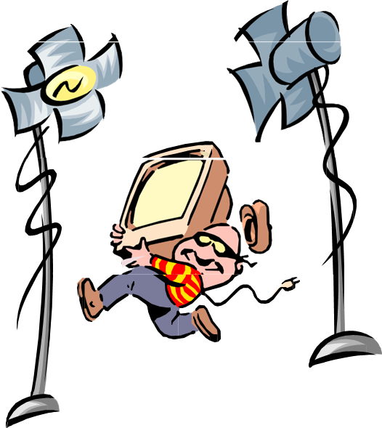
Security Lighting

Slide 9
Lighting
#1 deterrent against outdoor crime at night.
Consistent and uniform lighting is the key throughout the property.
Ethnicity of persons and color of vehicles should be distinguishable at 100 feet. (10 parking spaces)
Use of the same type fixture throughout the community helps maintain uniform lighting.

Slide 10
Lighting Problems
Obstructed Fixtures…
Can you see the light pole in
this picture?
Imagine how much light is
blocked by the tree.

Slide 11
Lighting Problems
Shake and break (lollipop, bobble head) lights are easy for people to break. This type of light is not recommended.
Head fixtures can be replaced with newer down lighting head covers that reduce light into the night sky which has a detrimental effect on astronomical observations and are designed to conserve energy and money, while increasing nighttime safety.
Light fixture that reflects are lights downward
lollipop/bobble head lights

Slide 12
Glare
Excessive brightness…
There can be both direct and reflected glare.
Direct glare occurs when a source of brightness is in the line of vision.
Reflected glare occurs when brightness from the source is reflected on a shiny surface which is in the line of vision.
Glare makes it hard to see which can create an unsafe situation.

Slide 13
Lighting Problems cont.
Glare from the light…
Do you see the person
In this picture?
Glare can be removed
by placing light fixtures
higher or using
deflectors.

Slide 14
Lighting cont.
Poor lighting Good lighting

Slide 15
Color Rendition
The type of light you use can make it difficult to see true colors in clothing, automobiles etc. The next slide gives you a very good idea of what different lighting sources look like and how they affect color.
(The vehicle is the same in the three photos shown on the next slide.)

Slide 16
Color Rendition
Poor Low Pressure Sodium Good High Pressure Sodium
Best Metal Halide

Slide 17
Marana Tri-Star Program C.P.T.E.D. Requirements
Trimming of trees up to 7’ minimum from ground.
Trimming of bushes not to exceed 3’ height max and be below windows.
Landscaping not to interfere with security lighting.
Uniform security lighting (ethnicity and color of vehicles should be distinguishable at 100 ft).
Single cylinder metal dead bolts on all single entry doors (with metal 1 inch-throw).
Dead bolt strike plates with minimum 2” screws (where construction permits).

Slide 18
Marana Tri-Star Program C.P.T.E.D. Requirements
180 degree eye viewer in all front doors.
Anti-lift and slide devices on sliding windows and doors.
Solid wood or metal undamaged doors and frames. (Replace/repair damaged doors)
Property clean, free of debris and hazards.

Slide 19
Conclusion
One seemingly insurmountable problem faced by law enforcement is insufficient manager and resident involvement in crime reduction. The police are a part of the community and have a vital interest in the wellbeing of the residents, but they cannot be totally effective without the involvement of property managers and residents. By bringing to your community a program that improves safety, security and the way residents feel about their wellbeing, literally improves the quality of life for tenants; making for a safer and more pleasant environment to live, work and raise families. To be effective, management, law enforcement and residents must work in partnership and share a common goal; crime reduction.

